Slide 1

N.B.K.R INSTITUTE OF SCIENCE & TECHNOLOGY (AUTONOMOUS) BACHELOR OF TECHNOLOGY IN COMPUTER SCIENCE AND ENGINEERING
SIMPLE E-COMMERCE CART SYSTEM
PRESENTED BY :
CH.SAI LAKSHMI 24KB1A05A0
CH.SADHVIKA 24KB1A05B5
CH.GIREESHA 24KB1A05B8
D.CHAITANYA SRI 24KB1A05D8

Slide 2
OBJECTIVE:
Develop a simple e-commerce cart system using arrays to store available products and a linked list to manage the user’s shopping cart, enabling efficient addition, removal, and display of cart items while maintaining a clear separation between inventory and user selections.

Slide 3
INTRODUCTION:
This project is a simple implementation of an E-commerce Cart System using the C programming language, designed to demonstrate basic concepts of data structures and procedural programming. The system simulates an online shopping experience where a user can view a list of available products and add them to a shopping cart.
In this project:
Available products are stored in a static array, allowing for quick access and easy display.
The shopping cart is implemented as a singly linked list, enabling dynamic memory allocation for user-selected items. This allows the cart to grow as needed during runtime.
The user can add products, view their cart, and see the total cost of items selected.

Slide 4
ADDING ITEMS TO THE CART
Title: Adding Items to the Cart
Visual: A simple illustration of a product page with an "Add to Cart" button.
User selects a product.
Clicks "Add to Cart" (or similar).
System identifies the product (Product ID).
Records the desired quantity (default often 1).
Temporary storage of item details (Session/Local Storage).

Slide 5
VIEWING THE CART
Title: Viewing Your Cart
Visual: A simplified table showing typical cart contents (Item, Quantity, Price, Subtotal).
Provides a summary of selected items.
Displays:
Item Name/Description
Quantity
Unit Price
Subtotal (Quantity × Price)

Slide 6
UPDATING QUANTITIES
Title: Modifying Item Quantities
Visual: An example of a cart item with a quantity input field and an "Update" button.
Users can change the number of items.
Quantity input fields are common.
An "Update" action applies the changes.
Cart automatically recalculates subtotals and the total.

Slide 7
REMOVING ITEMS FROM THE CART
Title: Removing Items from the Cart
Visual: An example of a cart item with a "Remove" button or link.
Users can delete unwanted items.
A "Remove" button/link is typically provided for each item.
Upon removal, the cart display updates.

Slide 8
CALCULATING THE TOTAL:
Title: Calculating the Cart Total
Visual: An example showing the sum of subtotals leading to the "Cart Total."
Sums the subtotals of all items in the cart.
(Mention briefly, if applicable for your scope): May include considerations for shipping, taxes, and discounts in more advanced systems.

Slide 9
ADVANTAGES:
Title: The Upsides of a Basic Approach
Ease of Implementation: (Icon: Gear or puzzle piece fitting easily) Quicker and often less complex to set up.
Lower Initial Cost: (Icon: Coin) Generally more affordable than feature-rich platforms.
User-Friendly (Potentially): (Icon: Smiley face) A clean interface can be intuitive for both sellers and buyers.
Focus on Core Sales: (Icon: Shopping bag) Directly facilitates the primary goal of selling products.
Good Starting Point: (Icon: Arrow pointing forward from a starting line) Ideal for new or small businesses.

Slide 10
LIMITATIONS:
Title: Where Simplicity Falls Short
Limited Features: (Icon: Puzzle piece with missing parts) May lack wishlists, advanced discounts, etc.
Scalability Challenges: (Icon: Graph line struggling to go up) Might not handle significant growth in traffic or orders.
Basic Customization: (Icon: Paintbrush with limited colors) Fewer options for branding and unique experiences.
Restricted Integrations: (Icon: Broken chain links) May not easily connect with other business tools.
Basic Reporting: (Icon: Simple bar chart) Limited insights into sales and customer behavior.

Slide 11
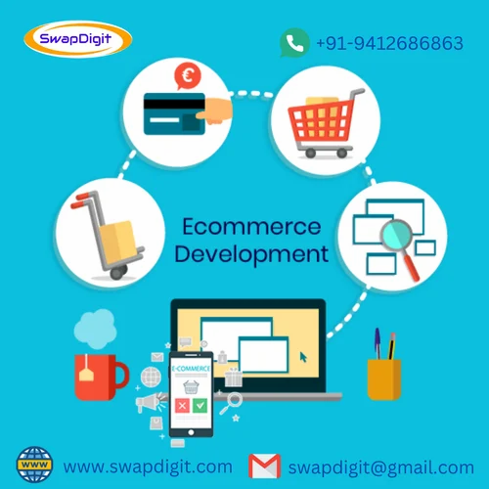


Slide 12
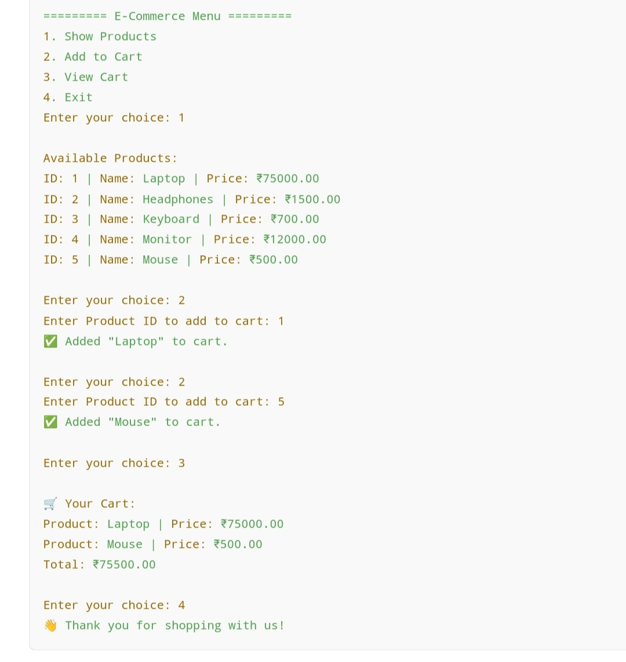
OUTPUT:

Slide 13
CONCLUSION:
Our simple e-commerce cart system provides the fundamental building blocks for online shopping.
It allows users to browse products, easily add them to a temporary cart, review and modify their selections, and see a running subtotal.
While lacking advanced features, this basic system demonstrates the core logic behind how online stores manage items before the checkout process.

Slide 14
THANK YOU……

